Slide 1
Movie Recommendation System
Barbara Schmitz
Data Mining 7118

Slide 2
The Goal
To create a movie recommendation system using the movielens 100k dataset
This is useful for the field of marketing where we see recommendation systems on platforms such as Amazon, and of course Netflix.
This has been difficult as in the past, Netflix has created a contest for the Best Recommender System with a $1 million prize.
Source: https://www.technologyreview.com/2006/10/06/273459/the-1-million-netflix-challenge/

Slide 3
Implementation
After cleaning the data and doing exploratory data analysis…
Principal Component Analysis
K-Means Clustering
Elbow Method
Collaborative Filtering

Slide 4
Assumptions
Users who rate movies similarly will be useful when suggesting an unseen movie to x-user.
Each cluster will be distinct via genre.
A larger dataset would yield more accurate results.

Slide 5
The Dataset (MovieLens)
Using the smaller dataset
Can be found here: https://grouplens.org/datasets/movielens/
Small: 100,000 ratings and 3,600 tag applications applied to 9,000 movies by 600 users. Last updated 9/2018.

Slide 6
The Dataset cont.,
Data dictionary:
Using 2 dataframe, a Movie and Rating dataframe.
For Movies, its features are
movieId : Unique id for each movie.
title : Name of the movie.
genres : list of genres of movie(Type-ex:Comedy)
For Ratings, its features are
userId : Unique id for each user.
movieId : Unique id for each movie.
ratings : Values which are rated by the user for each movie (0.5-5.0)

Slide 7
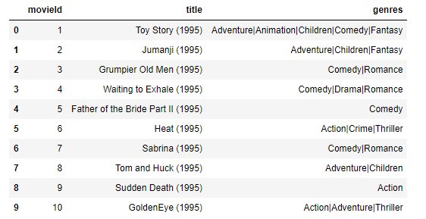
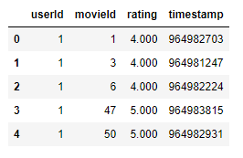
Data Cleaning
Want to separate the genres and extract time for title for year release.
Want to drop the timestamp for rating.

Slide 8
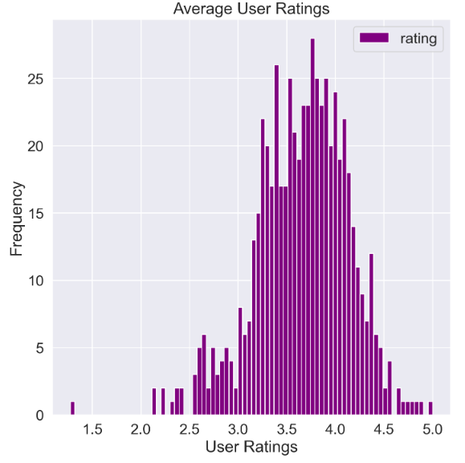
A Few Statistics
Most of the user Ratings fall between 3.0 and 4.0.
Looks Gaussian/Normally distributed.

Slide 9
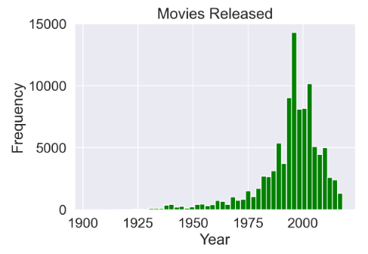
A Few Statistics
Most of the movies were released between 1990-2000.
Left-skewed distribution.

Slide 10
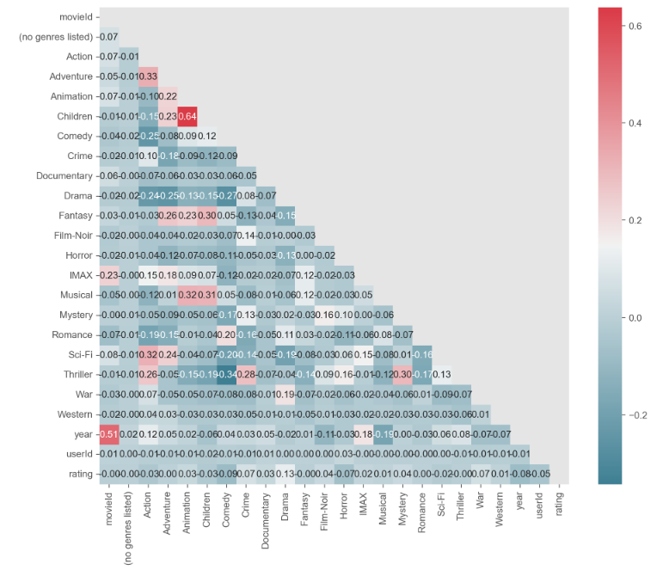
A Few Statistics
Correlations between genres
Animation and Children are bit highly correlated in the data (0.64)
Action and Adventure, Fantasy and Children, Sci-fi and Action are bit moderately correlated
Likely to be in similar clusters together

Slide 11
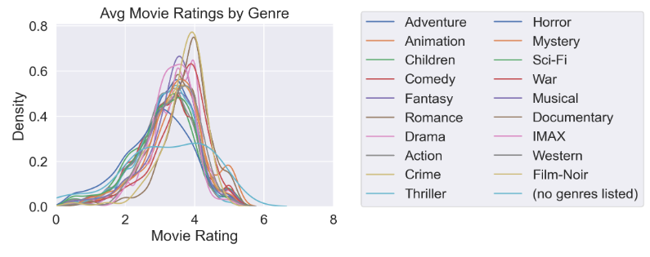
A Few Statistics
The density distributions of every genre.
People rarely rate movies lower than 3 stars, which contributes to a right-skewed distribution. The Thriller genre is bit normally distributed.

Slide 12
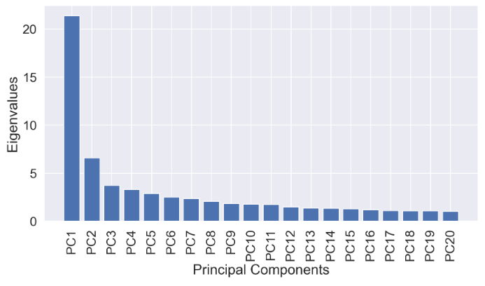
Principal Component Analysis (PCA)
Using PCA as a dimensionality method, we see much of the variance can be explained in 3 principal components because it tapers off.

Slide 13
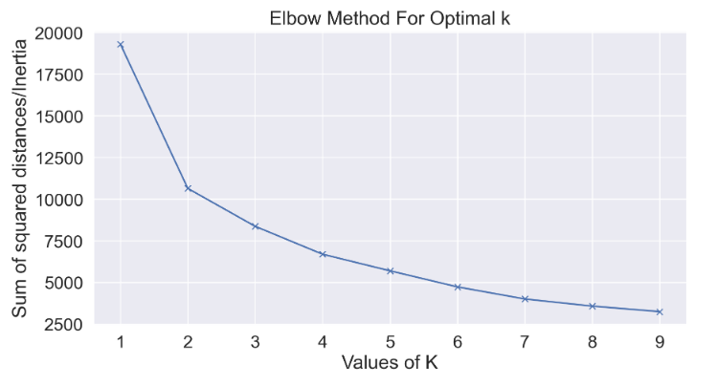
Elbow Method
For K-Means, to find the optimal k clusters, I used the elbow method.
It is unclear if 3 or 4 is the “elbow” so I choose 4 for the number for clusters for the K-means implementation.

Slide 14
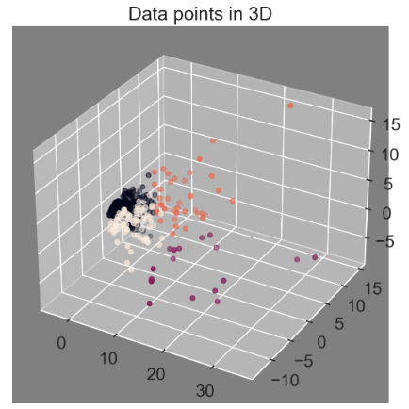
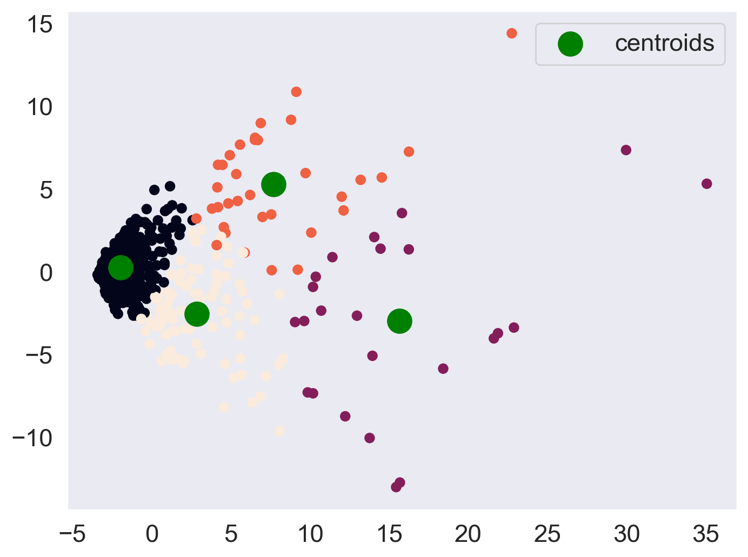
The 4 Clusters
Visualizing the clusters with optimal k=4 in 3D and 2D.

Slide 15
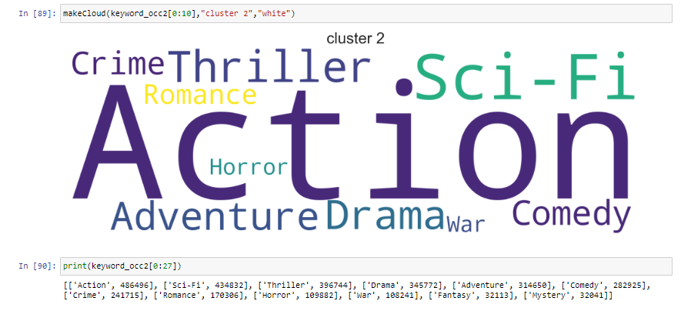
K-Means Clustering
As we can see in this cloud map, the top 10 genres in cluster 2.
I did this for all 4 clusters.

Slide 16
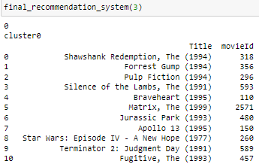
K-Means Recommendation System
To get recommended movies for User 3, I made a function to basically
Get a list of movie user-x has watched
Get the cluster number of user-x
Get a list of movies user-x has not watched
Get a list of top movies in cluster that user-x belongs to
Get movie title and movie id in cluster that user-x belongs to
Recommend the top 25 movies in said cluster user-x belongs to that user-x has not watched.

Slide 17


Collaborative Filtering – User Item
Using a user-based approach, I created a matrix for user-item based on userId, movie title, and rating.
I got a correlation value for users, set as user 1.
Predict user 222’s rating for movieID 365 (Forest Gump). This user has not rated this movie yet.
If the prediction rating is higher than the actual rating, then the system can recommend the movie to the user.

Slide 18
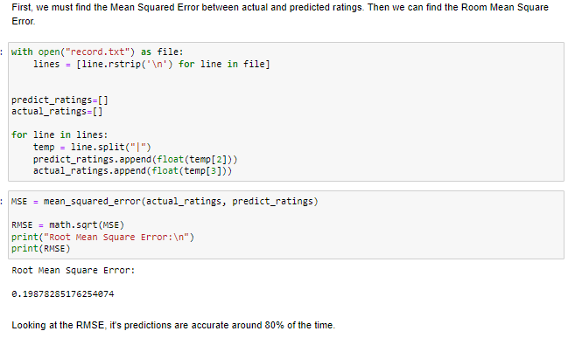
RMSE

Slide 19
Thank you!

